Slide 1





CampusCare
Smart Campus Management System
HACKATHON PROJECT · SMART EDUCATION
A Smarter Way to Manage Campus Problems
Domain
Smart Education
Team
Goat
Members
Rishikesh S · Sarfarazuddin k · Nivetha R
College
Easwari Engineering College
Notes:
Introduce the team and the project. CampusCare is a web platform where students report campus problems and administrators resolve them. Keep this slide to about 20 seconds.

Slide 2







Problem Statement
01 · PROBLEM
Students struggle to report campus issues
Complaints are often handled manually
No centralized complaint tracking
Delays in resolving urgent issues
Weak communication between students and administration
Scattered, untracked complaints
Notes:
Explain the daily reality: students do not know where to report a Wi-Fi, power or water problem, and complaints get lost because there is no single place to track them.

Slide 3


Our Solution
02 · SOLUTION
BEFORE
WITH CAMPUSCARE
Manual complaint handling
Centralized complaint reporting
Hard to submit issues
Easy issue submission
Issues sorted by hand
Automatic issue categorization
Urgent issues get delayed
Priority-based complaint management
No status updates
Real-time status tracking
Notes:
Walk through the rows left to right: each old pain point has a matching CampusCare answer.

Slide 4


Project Objectives
03 · OBJECTIVES
01
02
03
04
05
Simplify complaint reporting
Improve communication
Reduce resolution delays
Increase transparency
Improve campus management efficiency
Goal: one clear path from complaint to resolution
Notes:
Read the five objectives quickly. Each one links to a feature on the next slide.

Slide 5




Key Features
04 · FEATURES
Student Dashboard
Smart Issue Reporting
Automatic Categorization
Priority Detection
Personal view of your complaints
Simple form to raise issues
Sorts issues by type
Flags urgent issues first
Complaint Tracking
Admin Dashboard
Analytics and Reports
Follow status step by step
Manage and update complaints
Charts for campus insights
Notes:
Seven main features. Students use the dashboard, reporting form and tracking; admins use the admin dashboard and analytics.

Slide 6






System Architecture
05 · ARCHITECTURE
Users
Frontend
Backend
Database
Processing
Student / Administrator
HTML, CSS, JavaScript
Python Flask
SQLite
Complaint processing
Submit and manage complaints
Pages, forms and dashboards
Handles requests and logic
Stores users and complaints
Categorize, prioritize, update status
Status updates flow back to the student dashboard
Notes:
Follow the flow left to right. The user interacts with the frontend, Flask handles the logic, SQLite stores the data, and status updates come back to the user.

Slide 7






Technology Stack
06 · TECHNOLOGY
HTML
CSS
JavaScript
Structure
Styling
Interactivity
Python Flask
SQLite
Chart.js
Backend
Database
Analytics
Notes:
Frontend uses HTML, CSS and JavaScript. Backend is Python Flask with an SQLite database. Chart.js draws the analytics charts.

Slide 8


Working Process
07 · WORKFLOW
Login
Categorize
Review
Track
Student signs in
System sorts the issue
Admin checks the complaint
Student follows resolution
1
2
3
4
5
6
7
Submit
Prioritize
Update
Raise a campus complaint
Priority is assigned
Admin updates the status
Student
System
Administrator
Notes:
Seven steps from login to tracking. Purple steps are done by the student, cyan by the system, pink by the administrator.

Slide 9
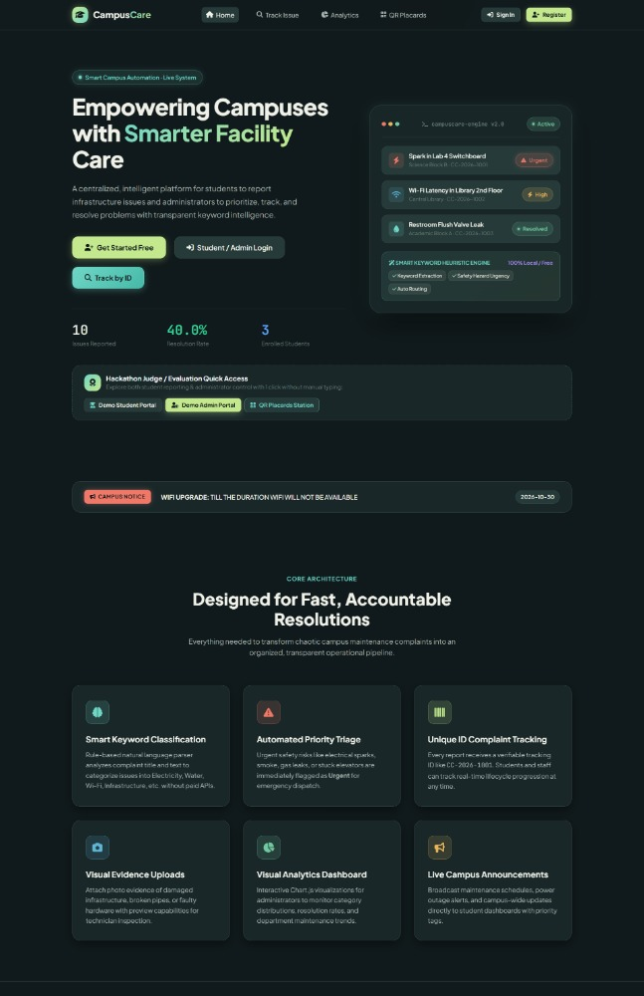
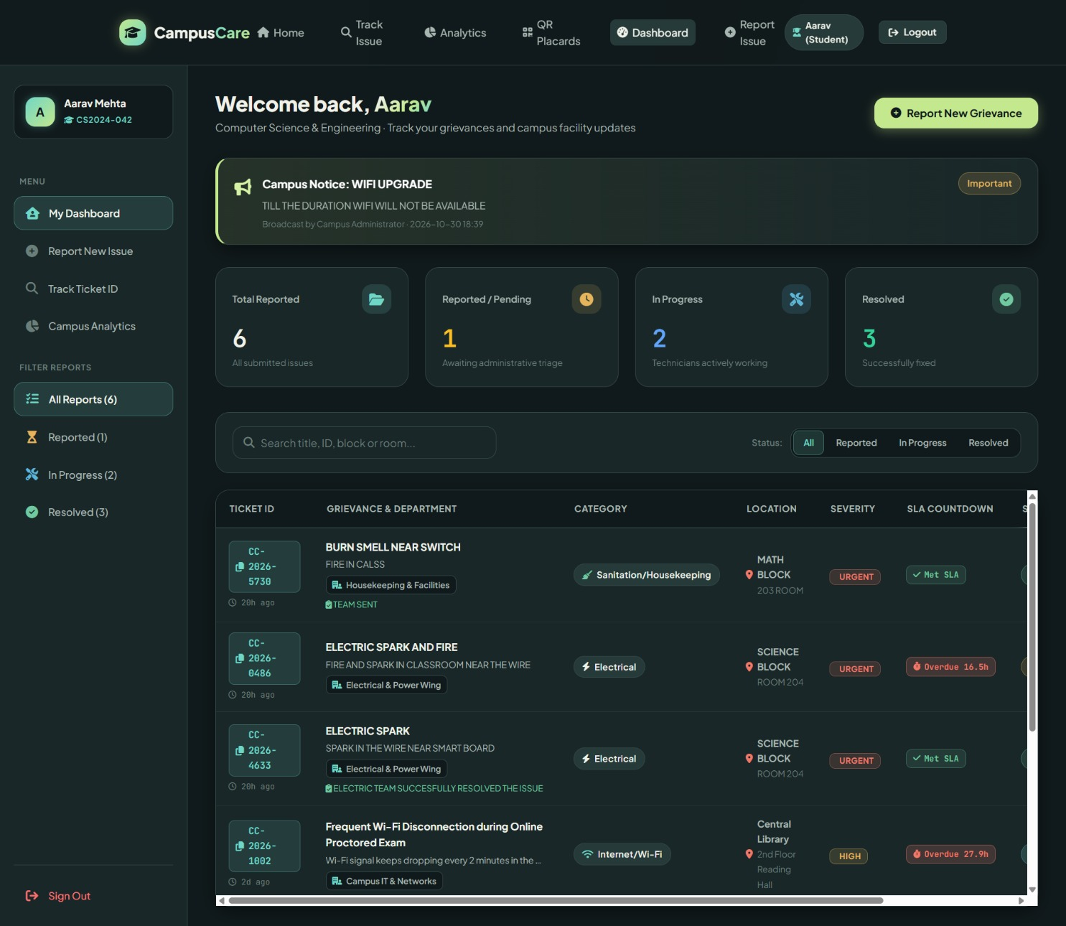
Application Screens
08 · USER INTERFACE
Landing Page
Student Dashboard
Notes:
Walk through the first two screens: the landing page where users start, then the student dashboard showing their complaints and statuses.

Slide 10
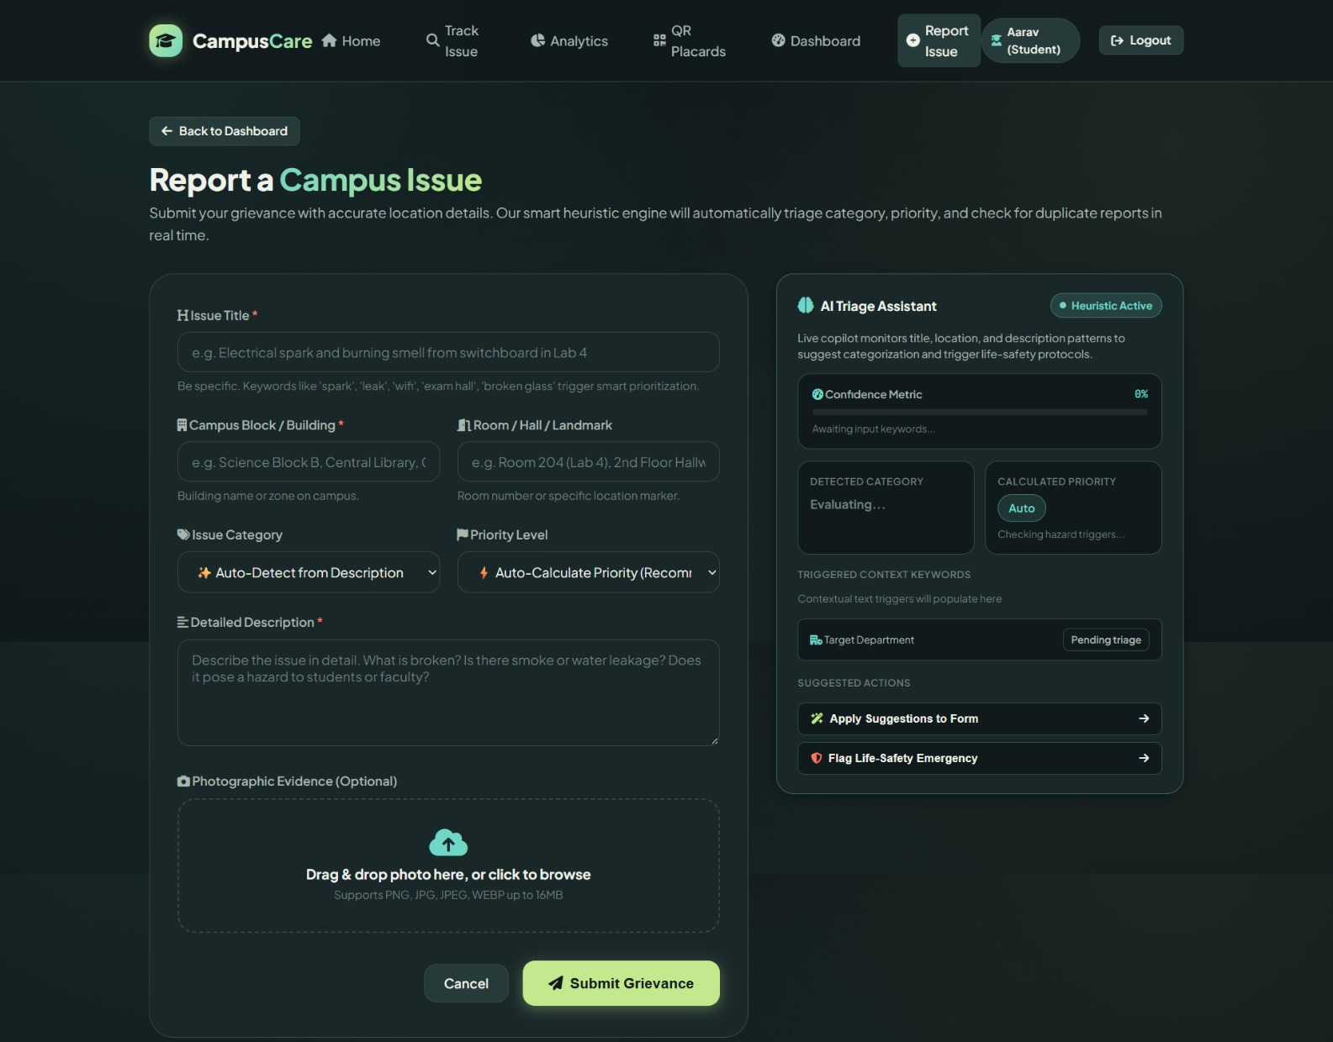
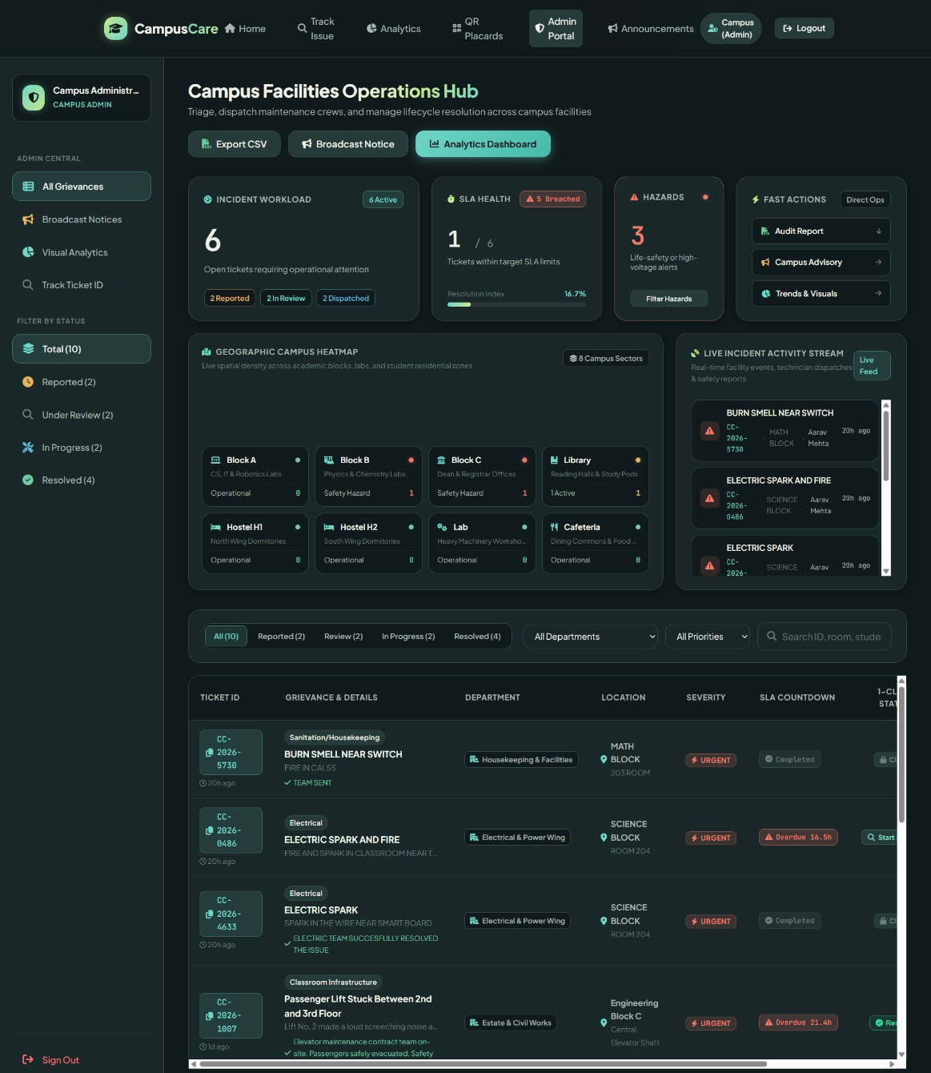
Application Screens
08 · USER INTERFACE
Complaint Submission
Admin Dashboard
Notes:
Show the complaint submission form with the AI triage assistant, then the admin dashboard where complaints are triaged and dispatched.

Slide 11
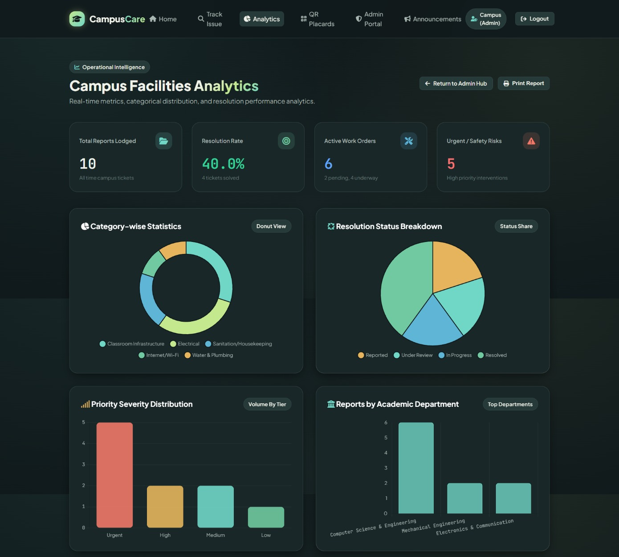

Application Screens
08 · USER INTERFACE
What the analytics screen shows:
Total reports, resolution rate, active work orders and urgent risks
Category-wise and status-wise breakdown charts
Priority severity distribution
Reports by academic department
Analytics Dashboard
Notes:
Finish with the analytics dashboard: totals, resolution rate and charts by category, status, priority and department.

Slide 12

Innovation and Uniqueness
09 · WHAT MAKES IT USEFUL
1
Automatic issue categorization
Issues are sorted by type
2
Priority-based complaint handling
Urgent problems are seen first
Simple tools, real campus value
3
Centralized complaint tracking
One place for every complaint
4
Transparent resolution process
Students see each status update
A clear, reliable workflow from complaint to resolution
5
Data-driven campus management
Dashboard charts support decisions
Notes:
Focus on practical value: one place to report, sort, prioritize, track and analyze complaints. No exaggerated claims needed.

Slide 13






Future Scope and Impact
10 · FUTURE SCOPE AND IMPACT
FUTURE SCOPE (PLANNED)
EXPECTED IMPACT
AI-based complaint classification
Mobile application
Faster complaint handling
Email and push notifications
QR-based complaint reporting
Better student experience
Improved administrative efficiency
Predictive maintenance
Multi-college support
Smarter campus operations
Notes:
These are planned enhancements, not features that are already built. The expected impact describes what the project aims to achieve.

Slide 14

Building Smarter Campuses with CampusCare
THANK YOU!
One centralized platform
Faster issue reporting
TEAM
Goat
Better communication
Efficient complaint resolution
CONTACT
srishikesh.1911@gmail.com/8946029878
Notes:
Recap in one sentence: CampusCare gives students and administrators one place to report, track and resolve campus issues. Then invite questions.

